Slide 1
Data Collection and DAta Wrangling

Slide 2
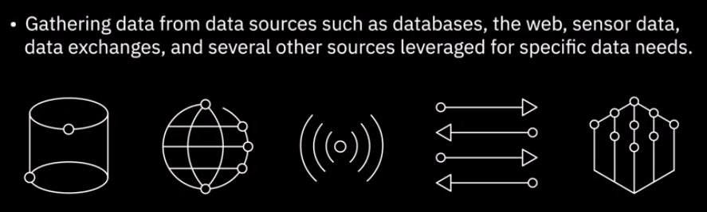
4. How to gather and import data

Slide 3
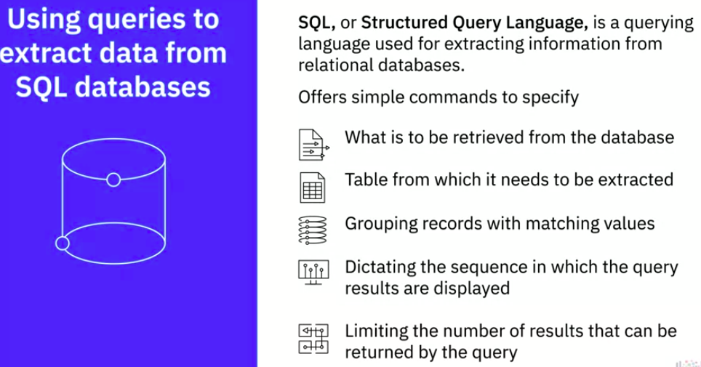
4. How to gather and import data - SQL

Slide 4
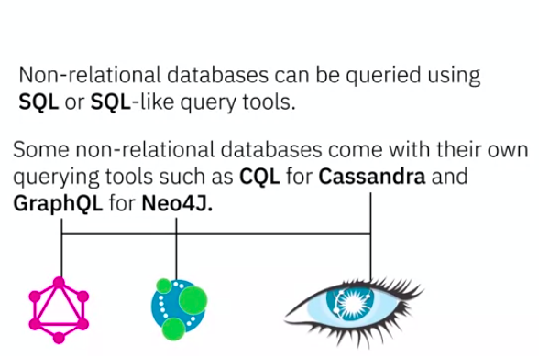
4. How to gather and import data - SQL

Slide 5
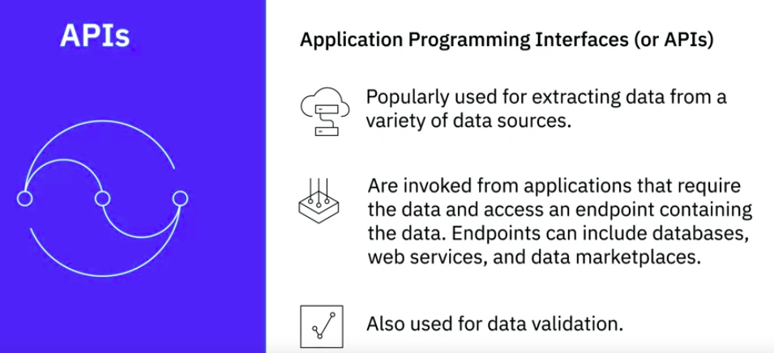
4. How to gather and import data - APIs
For example, a data analyst may utilize an API to validate postal addresses and zip codes

Slide 6
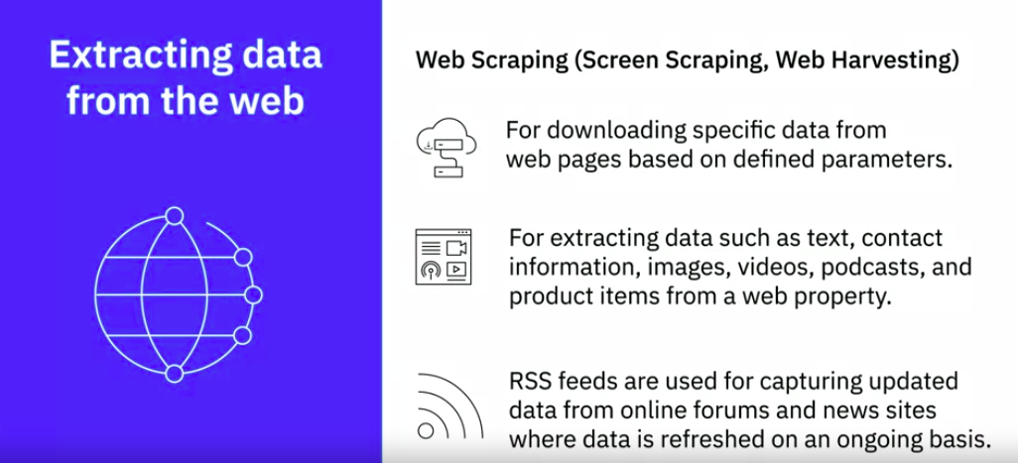
4. How to gather and import data - Web Scraping

Slide 7
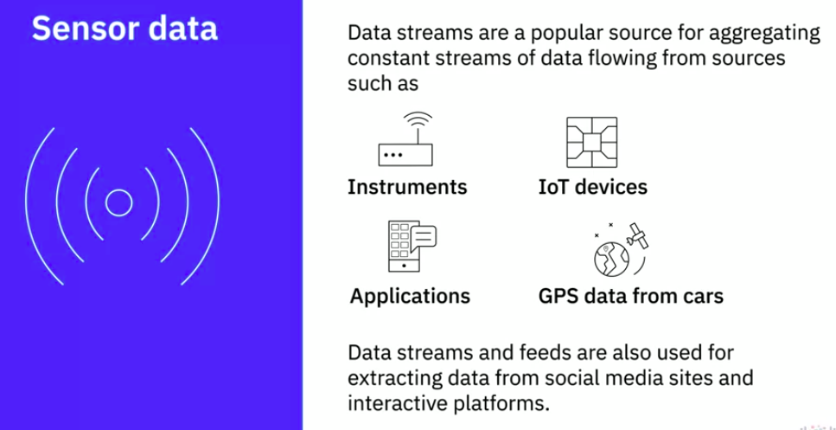
4. How to gather and import data - Sensor Data

Slide 8
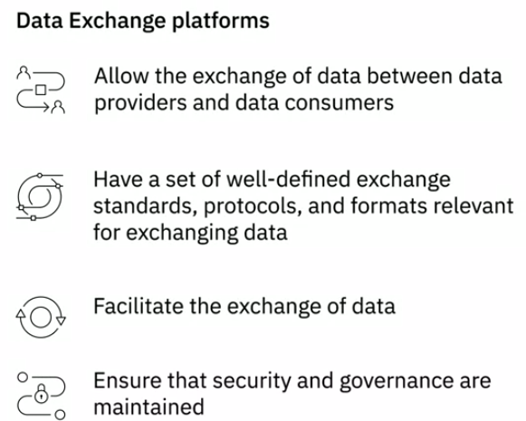
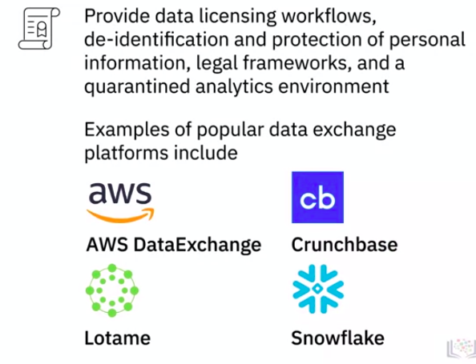
4. How to gather and import data - Data Exchanges

Slide 9
4. How to gather and import data - Data Exchanges

Slide 10
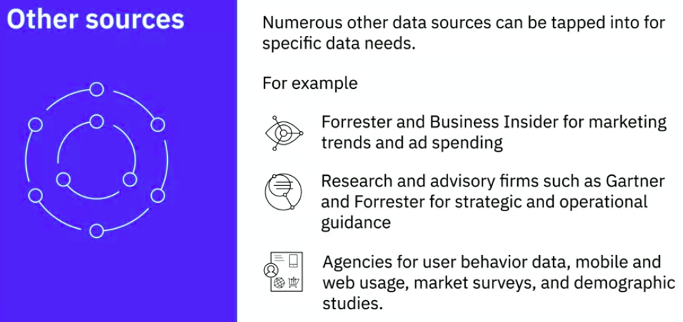
4. How to gather and import data - Other Sources

Slide 11
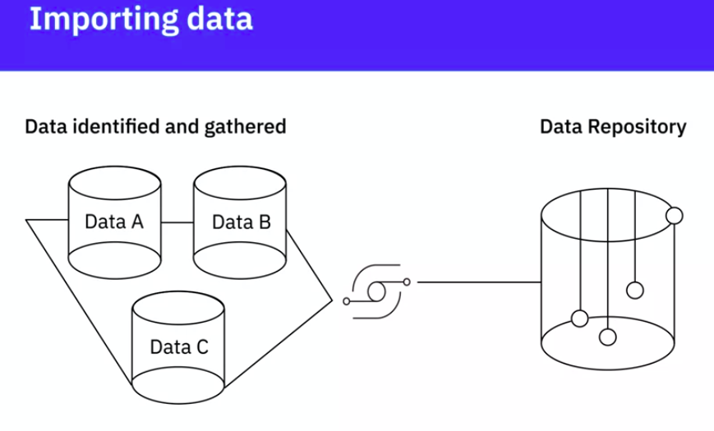
4. How to gather and import data - Importing Data
The importing process involves combining data from different sources to provide a combined view and a single interface using which you can query and manipulate the data. Depending on the data type, the volume of data, and the type of destination repository, you may need varying tools and methods

Slide 12
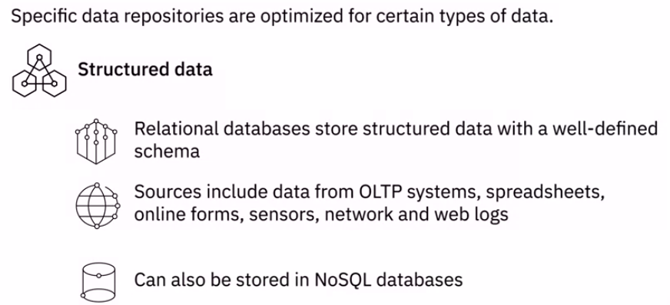
4. Data Types and destination repositories - Structure Data

Slide 13
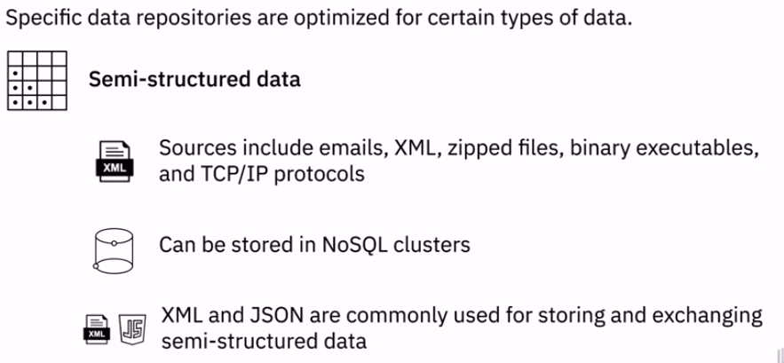
4. Data Types and destination repositories - Semi-structure Data

Slide 14
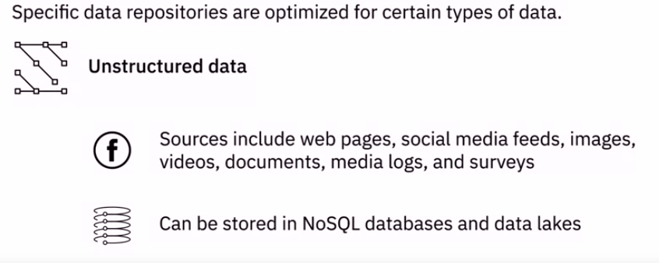
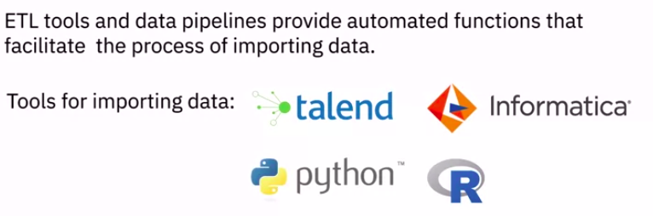
4. Data Types and destination repositories - Unstructure Data

Slide 15
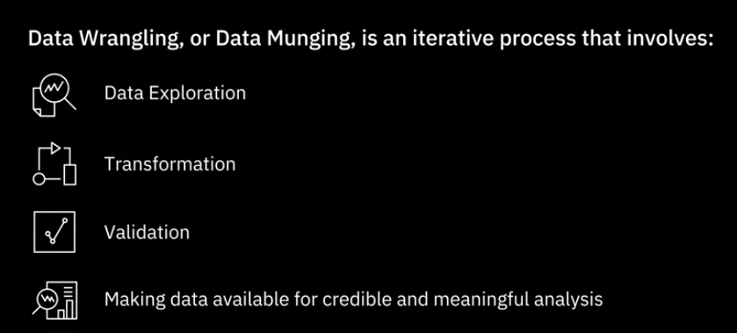
5. Data Wrangling
It includes a whole range of transformations and cleansing activities, some of which we will learn about in this lecture

Slide 16
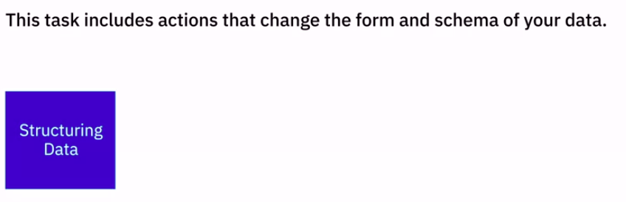
5. Data Wrangling - Transformation

Slide 17
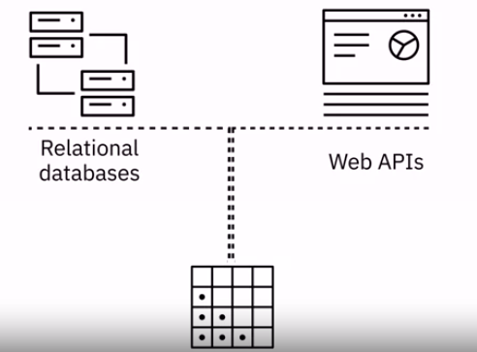

5. Data Wrangling - Transformation
The incoming data can be in varied formats. You might, for example, have some data coming from a relational database and some data from Web APIs. In order to merge them, you will need to change the form or schema of your data. This change may be as simple as changing the order of fields within a record or dataset or as complex as combining fields into complex structures.
Joins and Unions are the most common structural transformations used to combine data from one or more tables

Slide 18
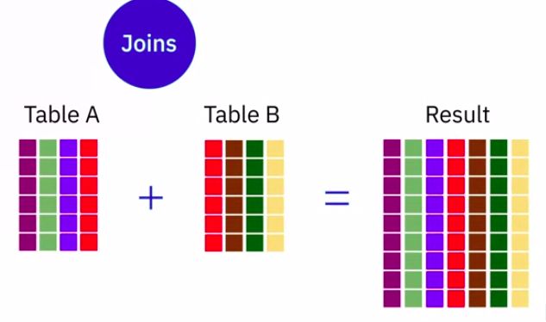
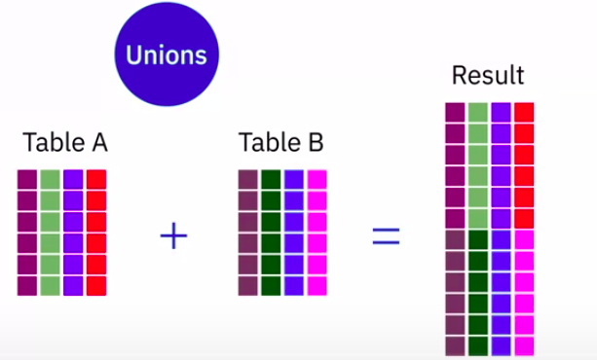
5. Data Wrangling - Transformation - Join and Union
Unions combine rows.
Rows of data from the first source table are combined with rows of data from the second
source table into a single table.
Each row in the resultant table is from one source table or another.
Joins combine columns.
When two tables are joined together, columns from the first source table are combined with
columns from the second source table—in the same row.
So, each row in the resultant table contains columns from both tables

Slide 19
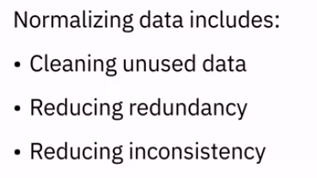
5. Data Wrangling - Transformation – Normalizing [CRUD]
for example, where a number of insert, update, and delete operations are performed on an ongoing basis, are highly normalized.

Slide 20
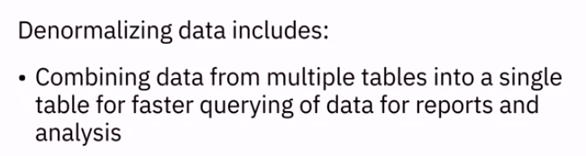
5. Data Wrangling - Transformation – Denormalizing [Joins and Unions]
For example, normalized data coming from transactional systems is typically denormalized before running queries for reporting and analysis

Slide 21
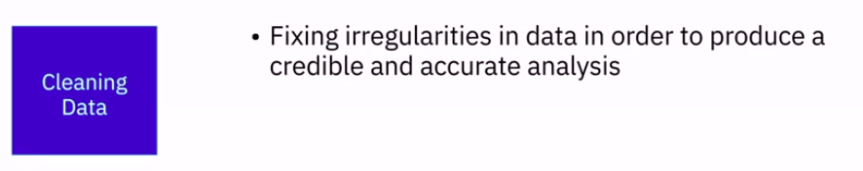
5. Data Wrangling - Cleansing

Slide 22
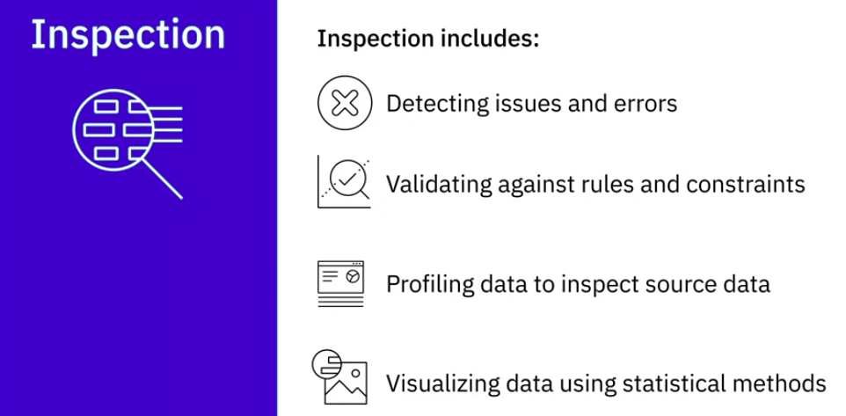
5. Data Wrangling - Cleansing - Inspection

Slide 23
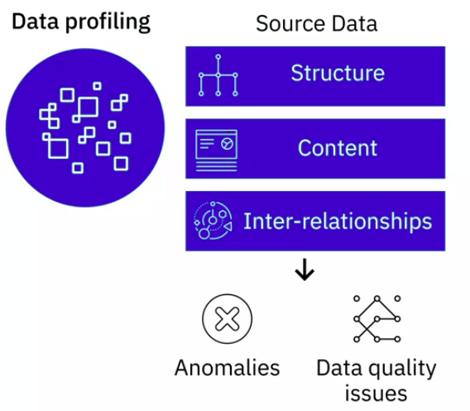
5. Data Wrangling - Cleansing - Inspection
For example, blank or null values, duplicate data, or whether the value of a field falls within the expected range. Visualizing the data using statistical methods can help you to spot outliers

Slide 24
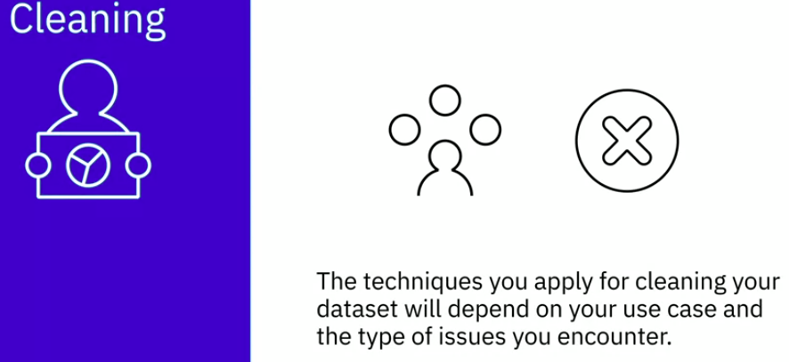
5. Data Wrangling - Cleansing

Slide 25
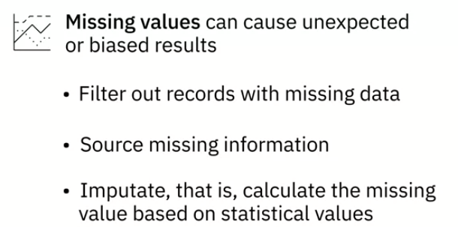
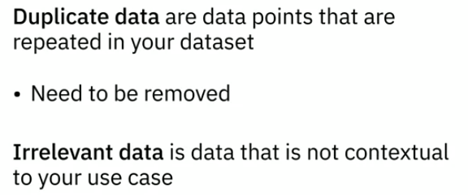
5. Data Wrangling - Cleansing - Common issues

Slide 26
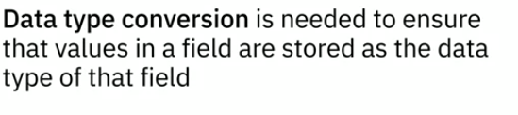
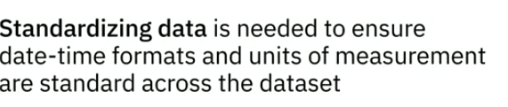
5. Data Wrangling - Cleansing - Common issues
for example, numbers stored as numerical data type or date stored as a date data type.

Slide 27
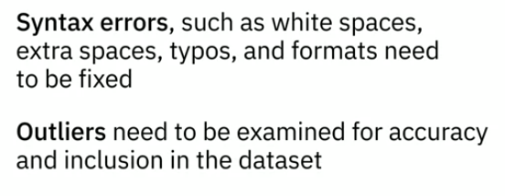
5. Data Wrangling - Cleansing - Common issues
For example - Syntax errors, white spaces, or extra spaces at the beginning or end of a string is a syntax error that needs to be rectified
For example - Outliers, when an age field in a voters database has the value 5, you know it is incorrect data and needs to be corrected

Slide 28
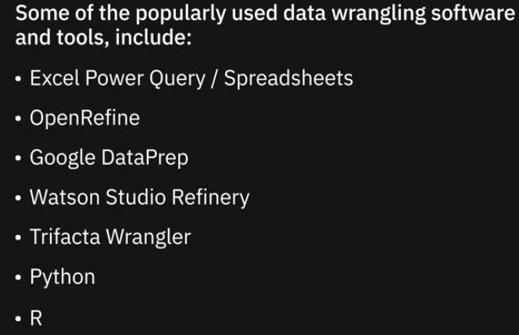
5. Data Wrangling - Tools

Slide 29
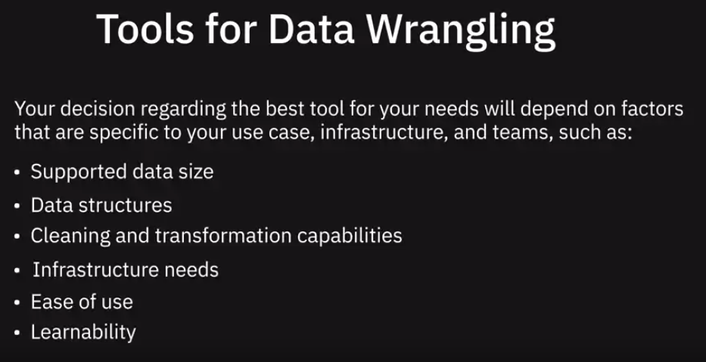
5. Data Wrangling - Tools

Slide 30
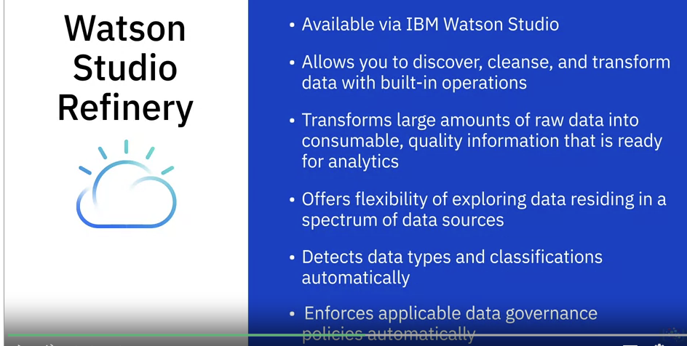
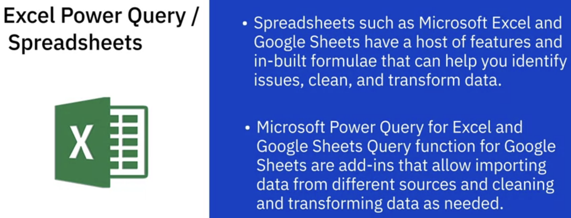
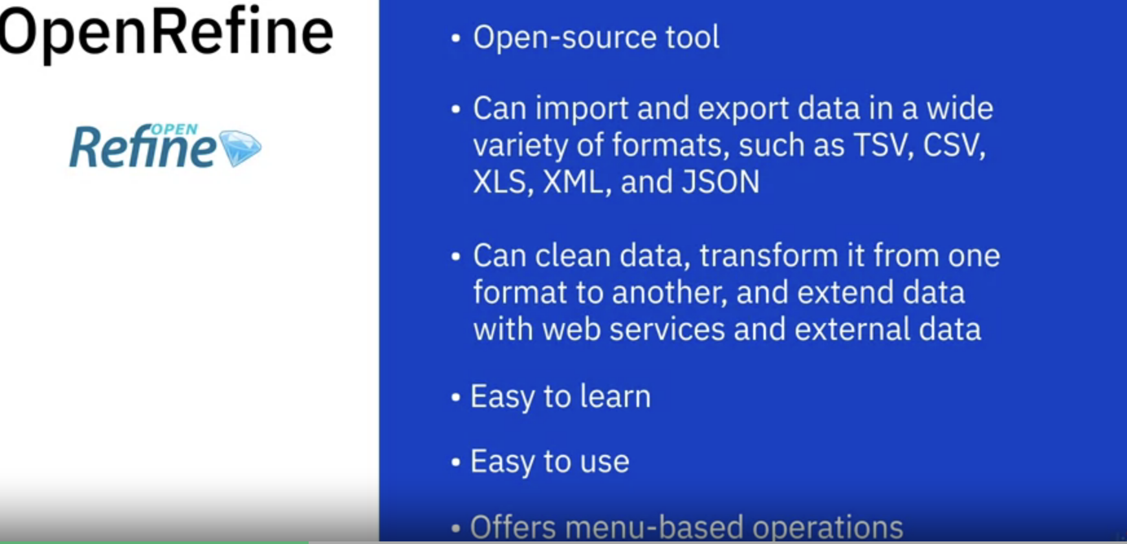
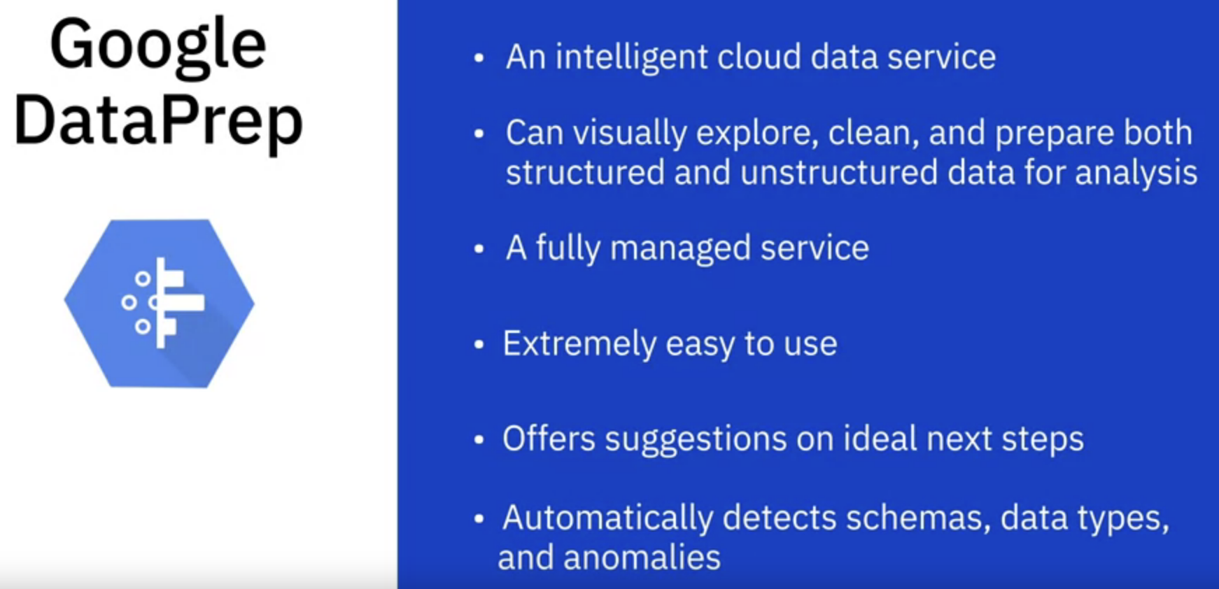
5. Data Wrangling - Tools

Slide 31
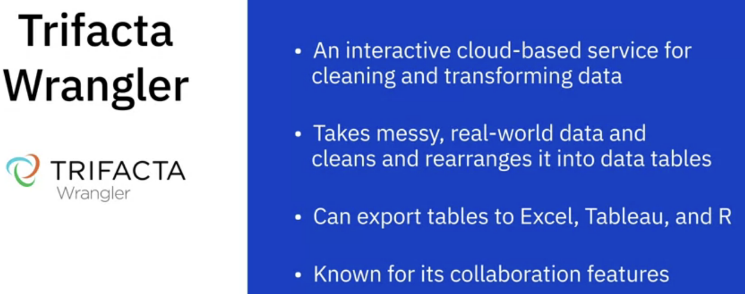
5. Data Wrangling - Tools
Python: Jupyter Notebook, Pandas, Numpy
R

Slide 32
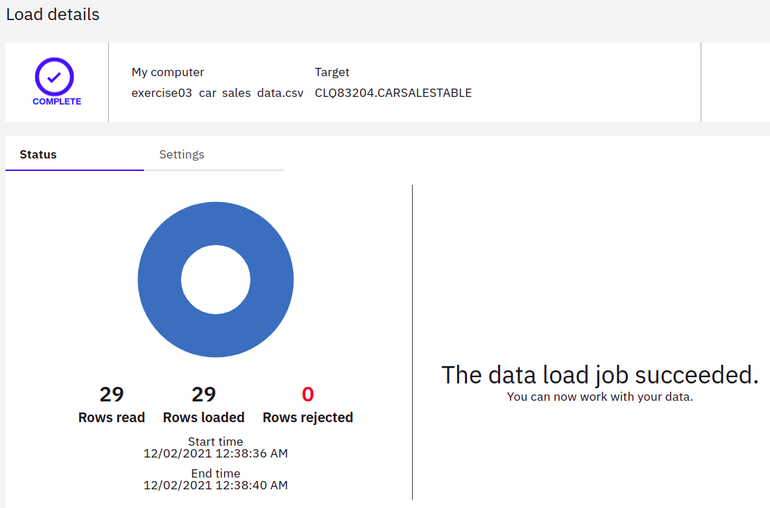
6. Upload csv file in IBM cloud
https://cf-courses-data.s3.us.cloud-object-storage.appdomain.cloud/IBM-DB0100EN-SkillsNetwork/labs/1.3.2.5_Hands-on_Lab_Load_data_into_Db2_Database3_from_CSV_file.md.html?origin=www.coursera.org

Slide 33
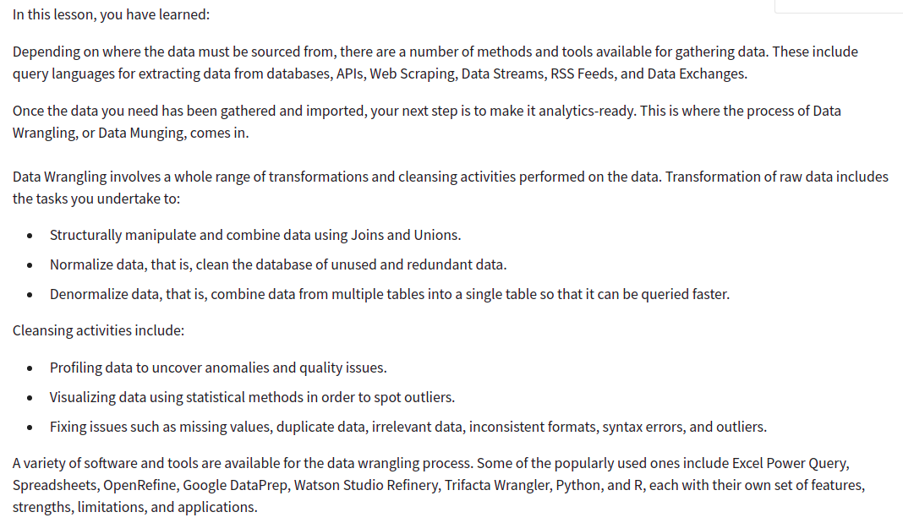
Recap

Slide 34
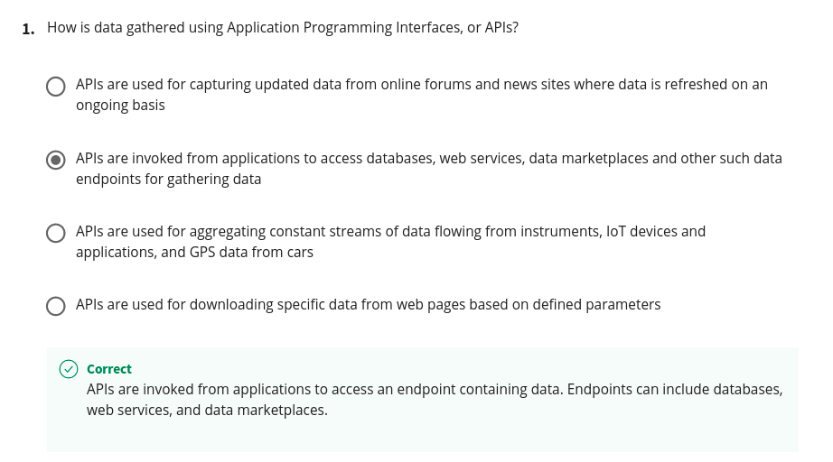
Quiz

Slide 35
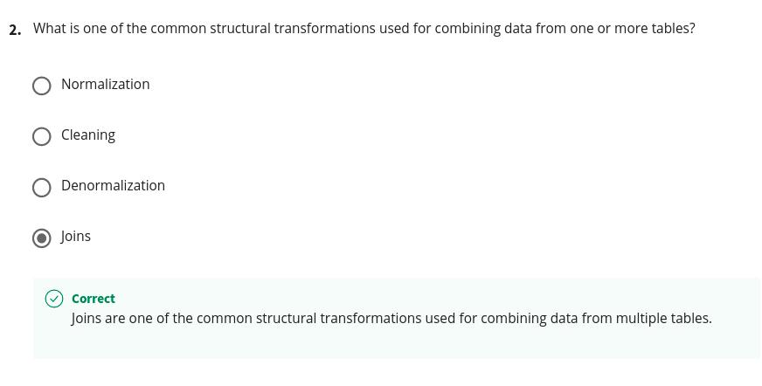
Quiz

Slide 36
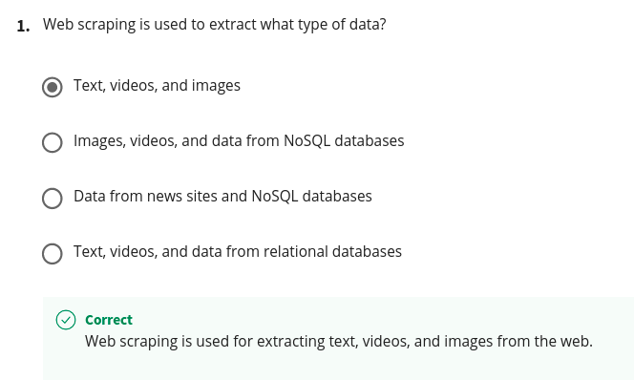
Quiz

Slide 37
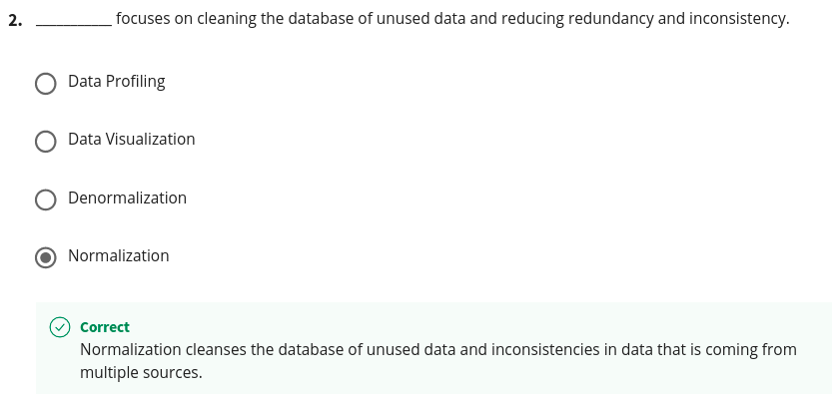
Quiz

Slide 38
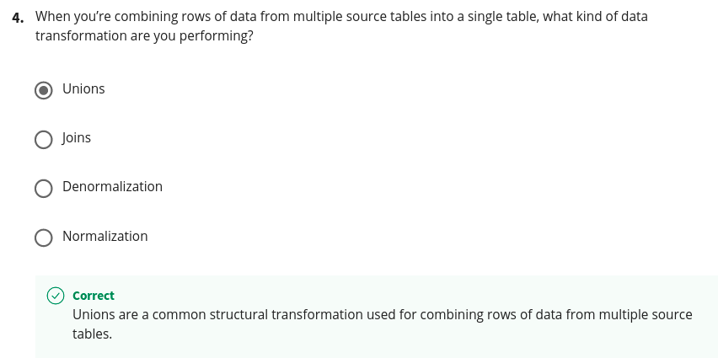
Quiz

Slide 39
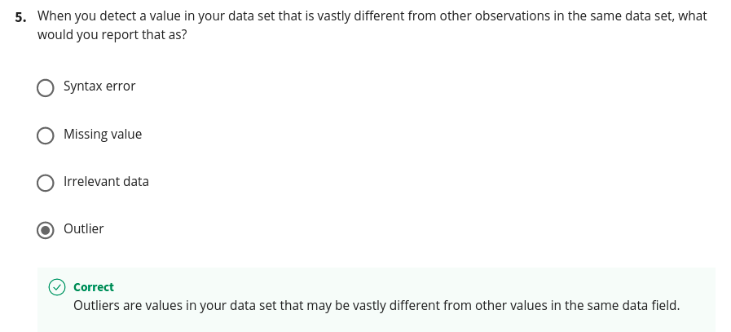
Quiz

